Slide 1
Creating a PWA
Colton Steeve
Dr. Denise Case

Slide 2
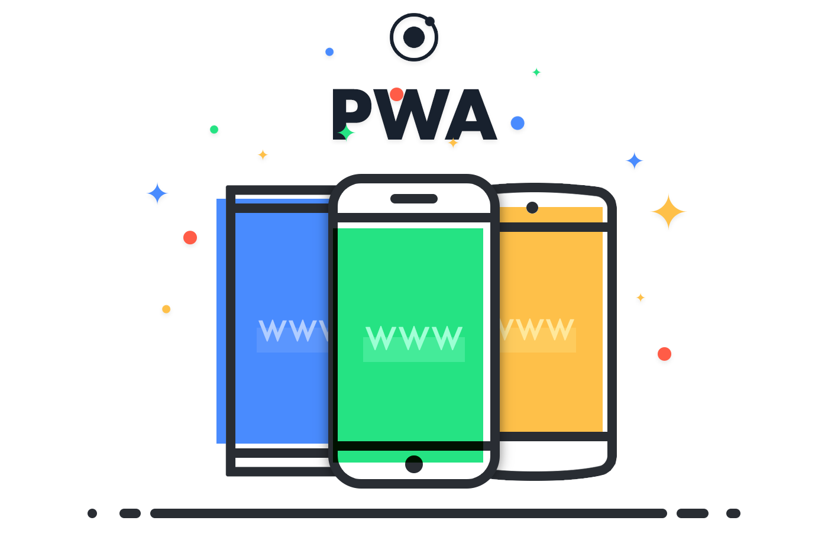
Agenda
Explain PWA’s
Test a PWA
Create a PWA
Summarize
Notes:
References-
PWA - https://miro.medium.com/max/2800/1*hWVmsnBY6Fr6OoNvIU5pmg.png

Slide 3

What is a PWA?
Progressive web applications are a type of application software delivered through the web, built using common web technologies including HTML, CSS and JavaScript.

Slide 4
Benefits of PWA’s
Install instantly
Use almost no storage space
Are cross-platform
Are capable of doing most of the things that native apps can do
Only require one code base

Slide 5



Examples of PWA’s
Twitter
Starbucks
Appscope
Notes:
References-
Appscope - https://appsco.pe/img/card.png
Twitter - https://pbs.twimg.com/profile_images/1111729635610382336/_65QFl7B.png
Starbucks - https://upload.wikimedia.org/wikipedia/en/thumb/d/d3/Starbucks_Corporation_Logo_2011.svg/1200px-Starbucks_Corporation_Logo_2011.svg.png

Slide 6
What you need to create a PWA
A service worker
A web app manifest
Some code in index.html that references both of the above
Icons
An IDE of some sort (I use Visual Studio Code)

Slide 7
What is a Service Worker?
A script that your browser runs in the background, separate from a web page, opening the door to features that don't need a web page or user interaction. It is used to cache resources for the PWA and to make events happen like the Install/Add to Home screen prompt.
Dr. Case

Slide 8
What is a Manifest File?
A simple JSON file (key:value pairs) that tells the browser about your web application and how it should behave when 'installed' on the user's mobile device or desktop. This stores references to the app name, the starting URL, the display type, the theme color, the icons and more.
Dr. Case

Slide 9
Test the PWA
Go to this URL and you will be able to install the PWA onto your computer and phone.
https://coltonsteeve.github.io/fact-pwa/

Slide 10
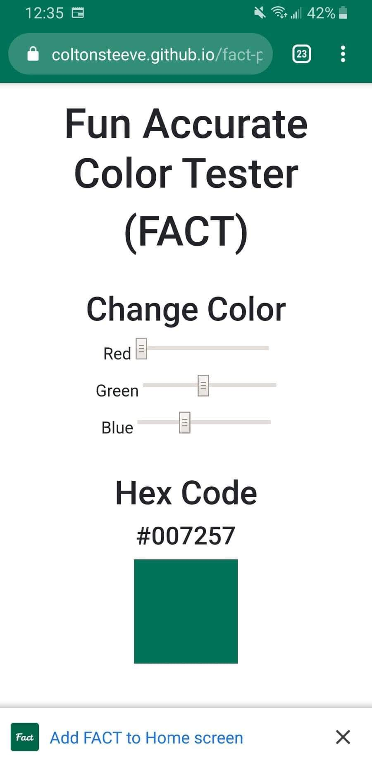
Testing on Android

Slide 11
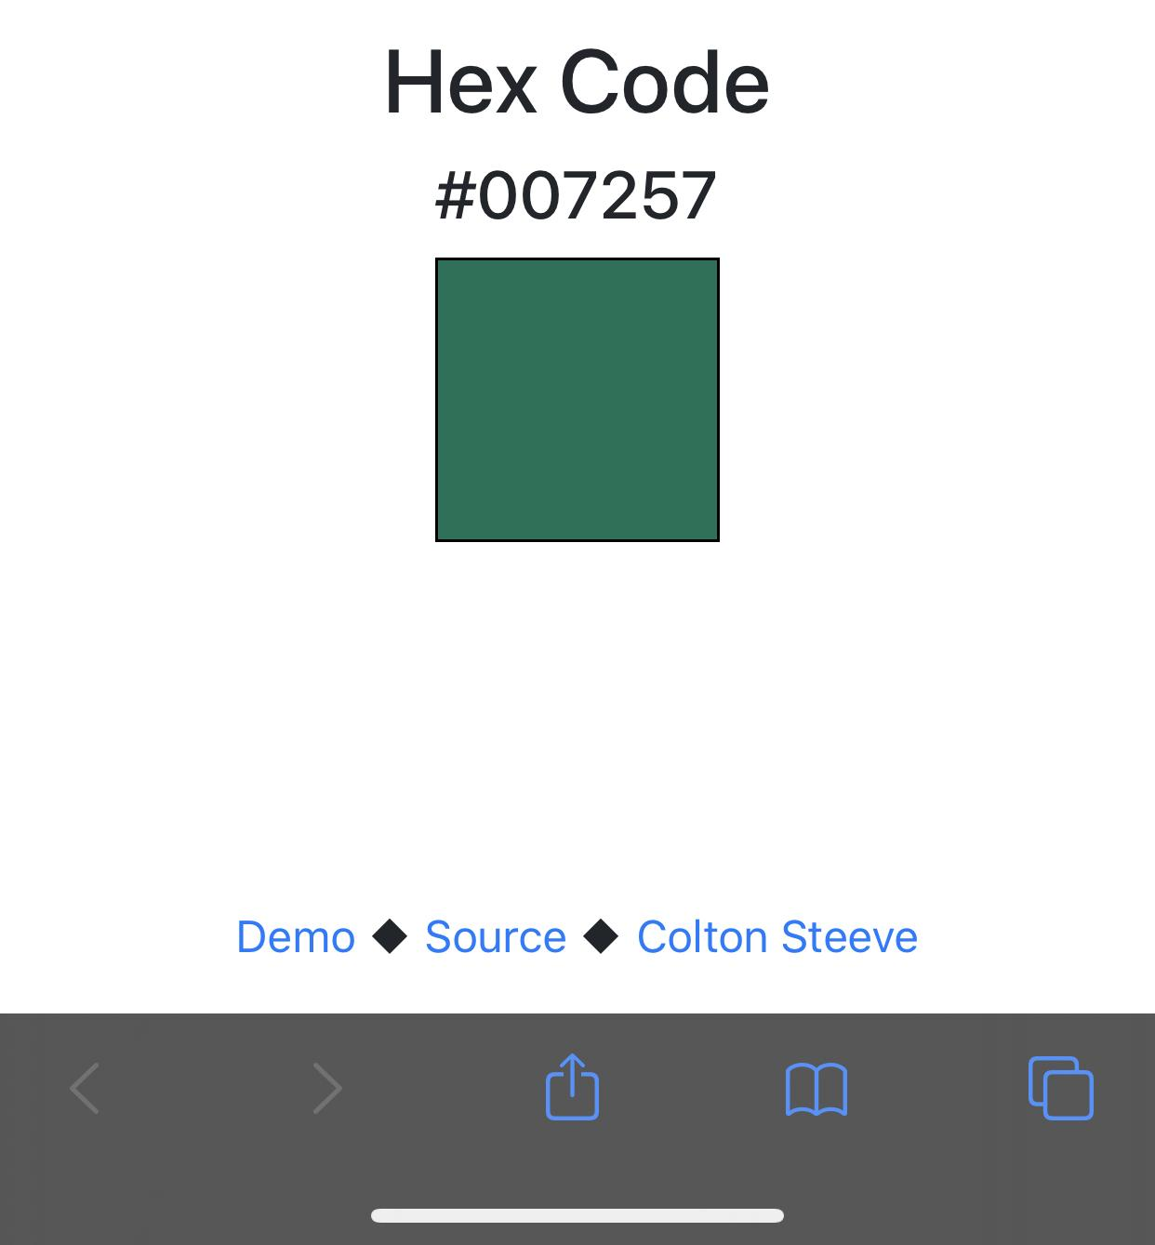
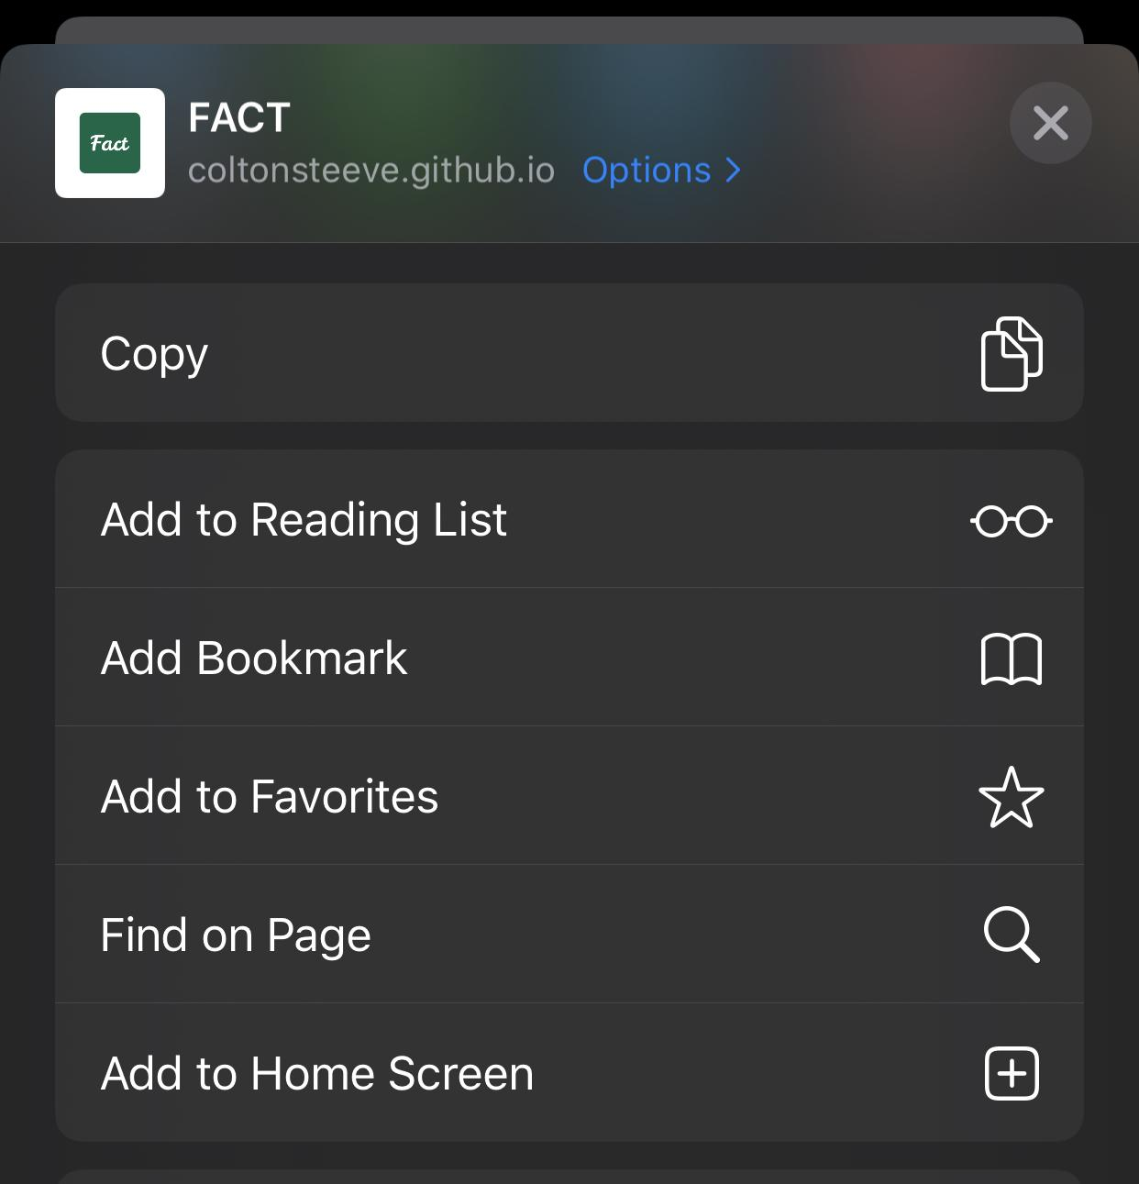
Testing on iOS

Slide 12
Creating the PWA

Slide 13
Download or Clone Repository
Go to these URLs and download or clone the repositories to your machine if you would like to try for yourself.
Baseline-
https://github.com/coltonsteeve/fact-no-pwa
Completed-
https://github.com/coltonsteeve/fact-pwa

Slide 14

Git
Git is a distributed version-control system for tracking changes in source code during software development. It can be used to coordinate work with other developers.

Slide 15
Installing Git
Search git on Google
Click on the first link that appears
Click on Downloads
Click on your operating system
The download should start, but if not, click on keep if you are using Chrome
Click the downloaded installer and follow the prompts to install Git

Slide 16
Installing Github Desktop or TortoiseGit
Go to one of these links for either Github Desktop or TortoiseGit
Github Desktop - https://desktop.github.com/
TortoiseGit - https://tortoisegit.org/
Keep in mind that TortoiseGit only works on Windows

Slide 17
Summary
A PWA is a web app that looks and feels like a native app
A service worker is a script that your browser runs in the background, which allows you to cache resources and make the Install/Add to Home screen prompt appear
A web app manifest is a file that tells your PWA how to behave when installed on a device
PWA’s are fun!

